Slide 1
Global Trends Project Presentation
By: Suman Bera

Slide 2
Agenda
Dataset Overview and Problem Statement
Life Expectancy Trends
GDP per Capita and Life Expectancy
Country Case Study: Switzerland vs Afghanistan
Statistical Insights and Visuals
Key Insights and Conclusion

Slide 3

Gapminder Overview
Gapminder mission is to fight devastating ignorance with a fact-based worldview everyone can understand.
Gapminder identifies systematic misconceptions about important global trends & proportions and uses reliable data to develop easy to understand teaching materials to rid people of their misconceptions.

Slide 4
Problem Statement
The modern world is shaped by complex dynamics in population, health, & economics, making understanding these trends vital for informed policy-making.
Global Trends, a leading analytics firm, is dedicated to deciphering these patterns through a comprehensive analysis of the Gapminder dataset.
Your role in this project is to conduct an in-depth Exploratory Data Analysis (EDA), uncovering the intricate relationships between demographic changes, economic development, and health advancements over recent decades.

Slide 5
Data Manipulation & Preprocessing
Transformed & Manipulated data using python’s Numpy & Pandas library
Fixed inconsistent values Corrected data type of ‘year’ column to datetime in ‘YYYY-MM-DD’ format
Checked missing/error values Checked the Errors & Null values throughout dataset and filled with appropriate values.
Generated new data and measures - Extracted decade that ‘year’ falls in new column ‘decade’ - Categorized the 'life_exp' into 4 equally ranged bins from 'Low' to 'Very High' in new column

Slide 6
Life Expectancy Trends
Global average life expectancy increased from 1952 to 2007
Factors: Improved healthcare, decline in infectious diseases, better sanitation

Slide 7
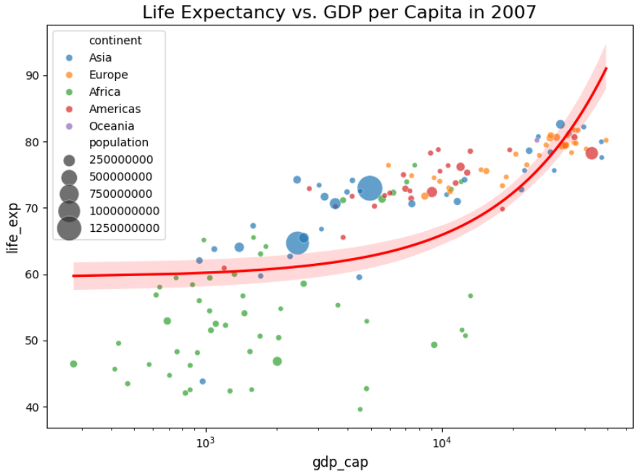
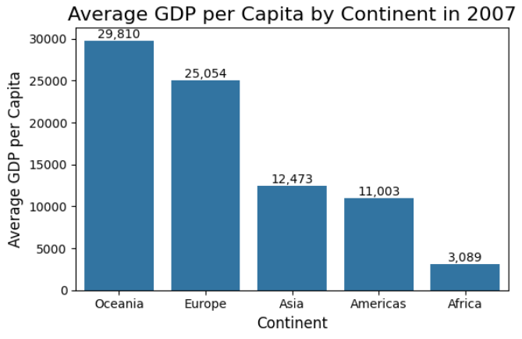
GDP per Capita and Life Expectancy
Strong positive correlation between GDP per capita and life expectancy
R-squared value of 0.73 indicates a significant relationship
Oceania had the highest average GDP per capita in 2007
Europe followed closely, while Africa had the lowest

Slide 8
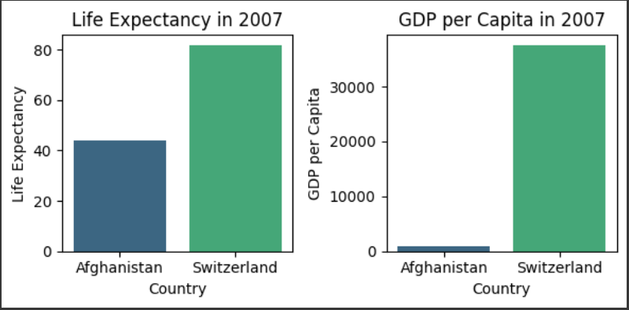
Country Case Study: Switzerland vs Afghanistan
Switzerland: Higher life expectancy and GDP per capita, steady growth
Afghanistan: Lower metrics, more volatility due to conflicts

Slide 9

Statistical Insights
Total Countries: 142
Total Population: 6.25 B (as of 2007)
Countries (Life Exp > 80 years): 13 (as of 2007)
Avg Life Expectancy: 67yr (as of 2007)
Avg GDP per capita: $ 11.7K (as of 2007)

Slide 10
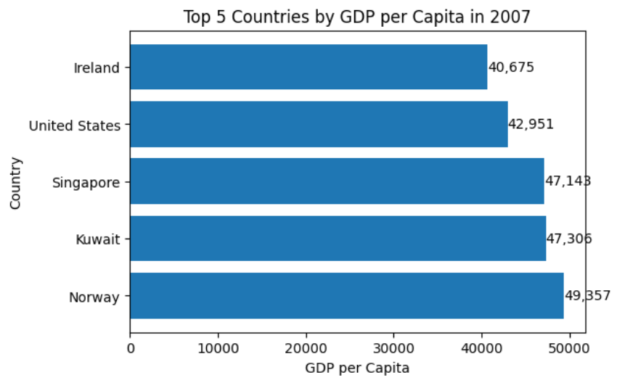
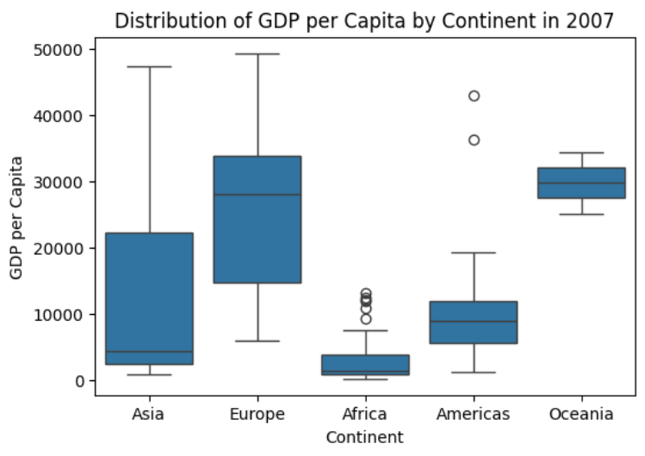
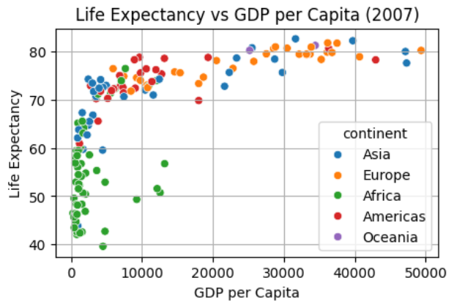
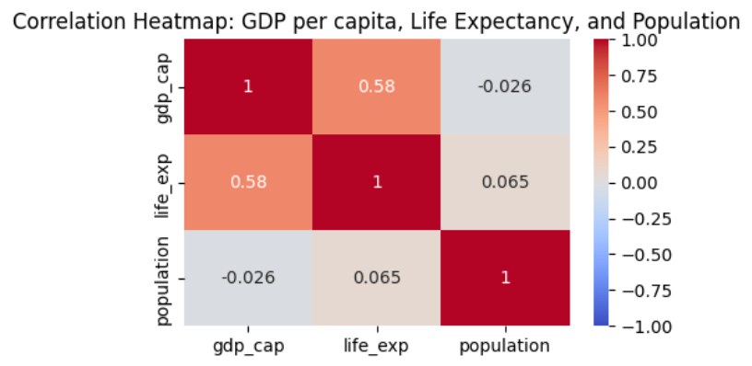
Visualizations

Slide 11
Key Insights
Top 5 countries with highest GDP per Capita (as of 2007): Norway, Kuwait, Singapore, United States, Ireland
There is a positive correlation between GDP per capita and life expectancy. As GDP per capita increases, life expectancy also tends to increase.
Countries with higher economic development (higher GDP per capita) tend to have better health outcomes, as indicated by higher life expectancy.
- European countries are the most tightly clustered, suggesting a more uniform standard of living and health outcomes across the continent. - African countries are more spread out, indicating more variability in economic and health outcomes
- The average GDP per capita for Oceania is higher than the Americas because Oceania includes countries which have very high GDP per capita. - In contrast, the Americas include a mix of countries with varying levels of GDP per capita, including some with much lower GDP per capita, which brings down the average.

Slide 12
Conclusion
There’s a strong link between economic prosperity (GDP per capita) and health outcomes (life expectancy), with clear disparities across different continents. While higher GDP per capita generally correlates with higher life expectancy, there are significant regional variations and outliers that suggest other influencing factors.
Stability plays a crucial role in determining both life expectancy and economic development. Countries with stable political environments and strong institutions tend to have higher life expectancy and better economic outcomes.
The visualizations highlight the long-term trends in life expectancy and GDP per capita, showing how stability and development policies impact these metrics over time.
The stability or instability of a country significantly influences key metrics such as life expectancy and economic development.
well-developed healthcare & financial system, better access to medical services & education, action against corruption and addressing ongoing conflicts in any country is needed for their progress & development

Slide 13
Thank you
Suman Bera
+91-7501823400
sumanberapapai1@gmail.com

